Slide 1

High Impact Skills Development Program
in Artificial Intelligence, Data Science, and Blockchain
Module 1: AI Fundamentals
Lecture 1: Introduction to AI
Instructor: Dr Latif Anjum
NUST – SEECS

Slide 2
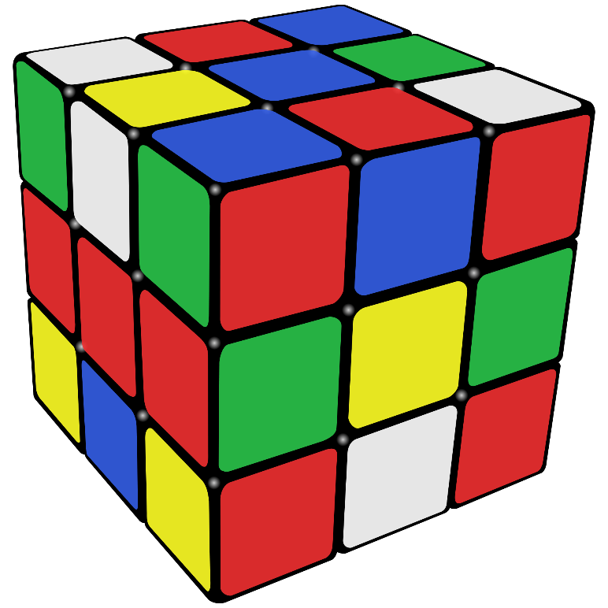
What is Artificial Intelligence?
First we have to define “intelligence”
How many of you are intelligent?
Notes:
Clips: terminator 2, enemy of the state (from UCSD “Fact or Fiction” DVD)

Slide 3
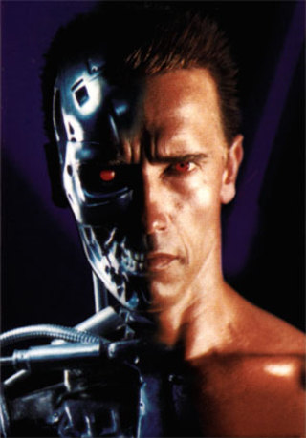

What is Artificial Intelligence?
Terminator 2 - 1991
Sophia - 2016
Notes:
Clips: terminator 2, enemy of the state (from UCSD “Fact or Fiction” DVD)

Slide 4
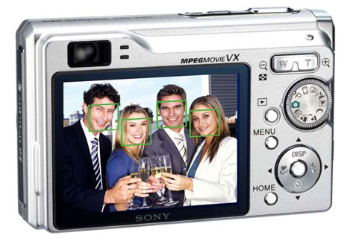
Artificial Intelligence Applications
Digital cameras detect faces for face priority focus
Canon, Sony, Fuji, smart phones, …
Notes:
Why would this be useful? Main reason is focus. Also enables “smart” cropping.

Slide 5
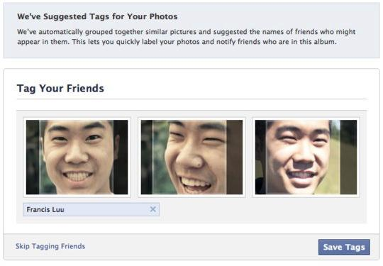
Photo Auto-tagging

Slide 6
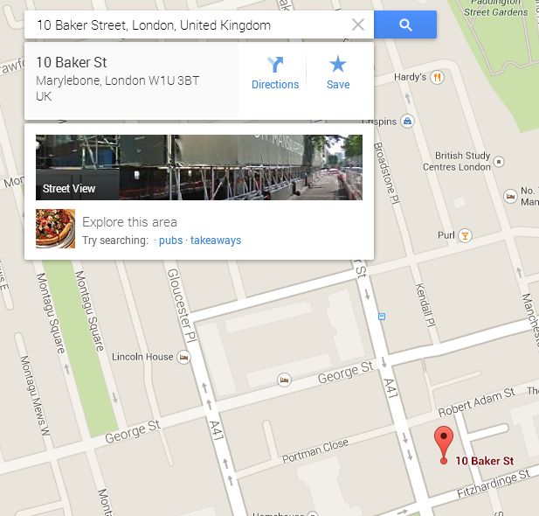
Google Maps

Slide 7
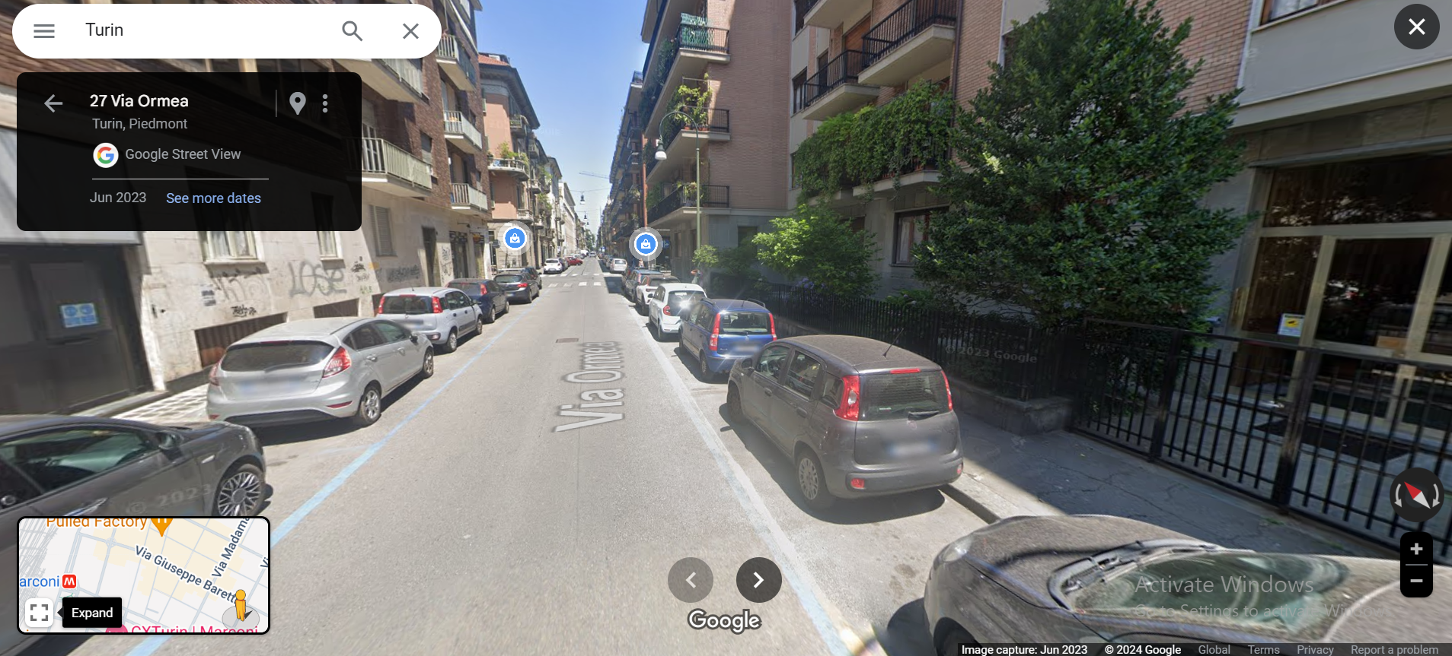
Google Maps – Street View

Slide 8
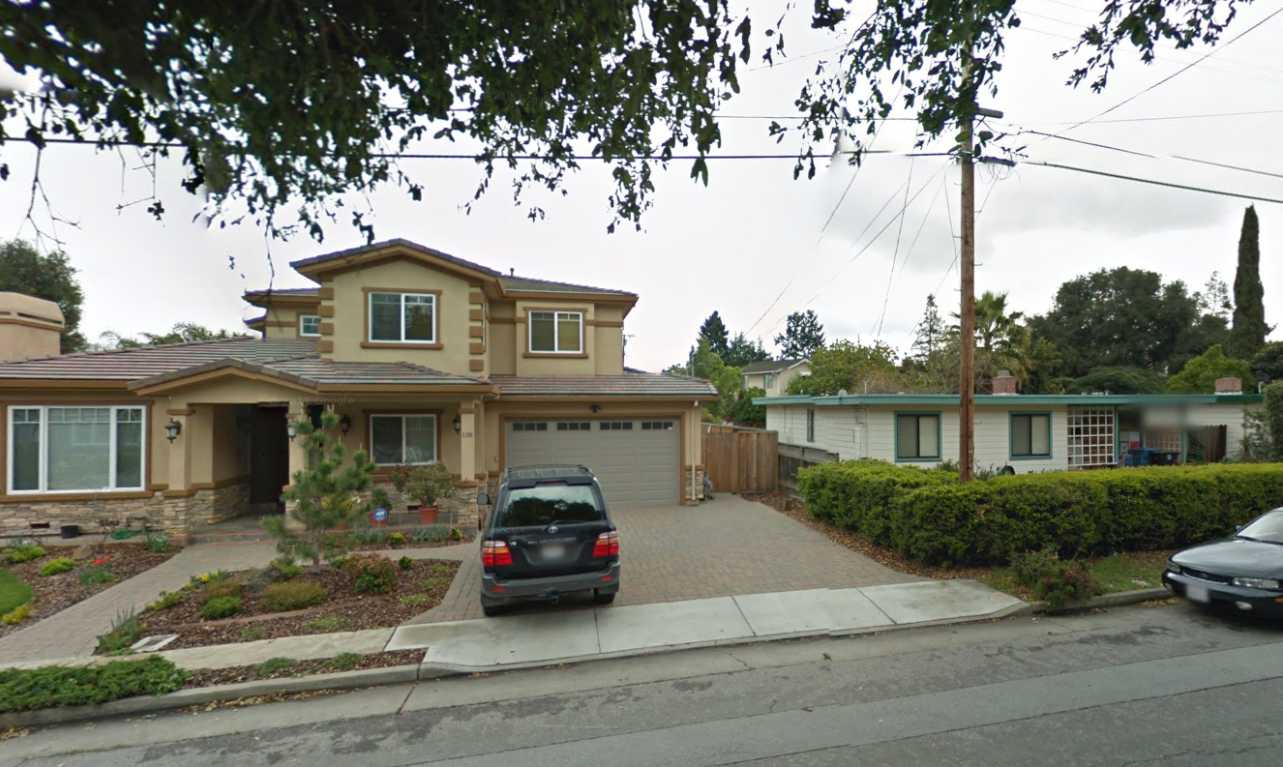
Street View – Reading Street Numbers

Slide 9
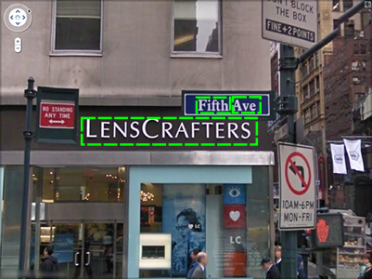
Google Street View Dataset

Slide 10
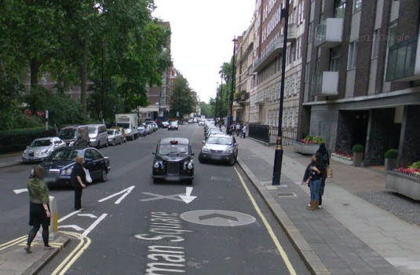
Street View – Hiding Personal Details

Slide 11
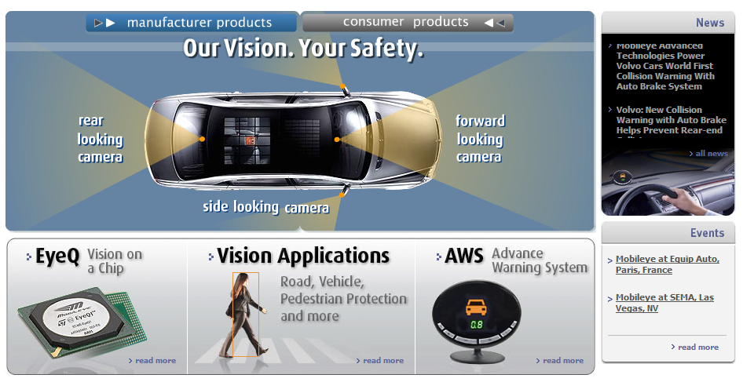
Smart Cars
Slide content courtesy of Amnon Shashua

Slide 12
Mercedes S 500 Self-Driving Car

Slide 13

What is Machine Learning?

Slide 14
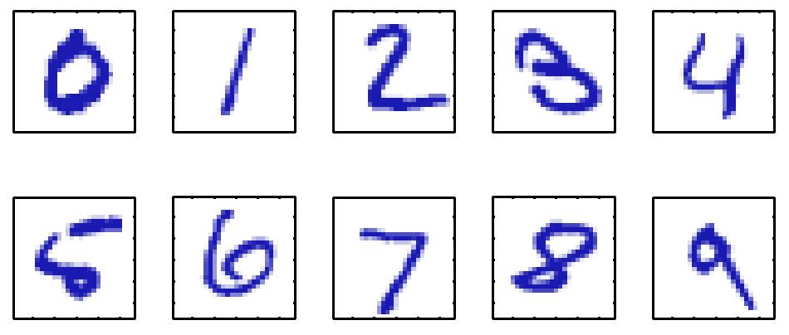
Example
Handwritten Digit Recognition

Slide 15
Goal of Machine Learning
Consider a 28 x 28 pixel image
Represented by a 784 dimensional vector x
Goal: build a machine that takes the vector x as input and produces the identity of digit 0,…,9 as the output
Tom Mitchel’s definition of Machine Learning: A computer program is said to learn from experience E with respect to some class of tasks T and performance measure P, if its performance at tasks in T, as measured by P, improves with experience E.

Slide 16
Important terminology
Training data
Data samples
Target vectors
Learning / Training
Machine takes training data and automatically learns mapping from data samples to target vectors
Test data
Target vectors are concealed from the machine
Machine predicts the target vectors based on previously learned model
Accuracy can be evaluated by comparing the predicted vectors to the actual vectors

Slide 17
Types of Machine Learning Problems

Slide 18
Types of Machine Learning Problems
Supervised learning
Regression
Classification
Unsupervised learning
Clustering
Density estimation

Slide 19
Course Outline
Machine Learning Fundamentals (OHT-1)
Machine Learning Applications (OHT-2)
Search and Problem Solving with AI (ESE)
Grading Policy
10% Quizzes
10% Assignments
10% Project
15% OHT-1 (One Hour Test -1)
15% OHT-2 (One Hour Test-2)
40% ESE (End Semester Exam)

